Slide 1
Institute of advanced computing and software development Student portal for iacsd
Presented by : 219073 - Samiksha hogade. Submitted to: Mrs.Shilpa pawale mam.
219192 – Shubham thorat. .

Slide 2
introduction
The term portal is known as links page which presents information from diverse sources in a unified way.
Portals provide a way for enterprises to provide a consistent look and feel with access control andprocedures for multiple applications and databases.
Student portals serve academic institutions in a variety of ways, the most important of which is centralized data administration and accessibility.

Slide 3
Objective
The purpose of this study is to develop a web based online student Portal that as a solution to the problems of the students and faculty currently in the institution.
This student portal for IACSD project’s objective is of being in significant way by providing most basic and most essential functionalities and features to its users in efficient and effective manner.
And the goal is to ease admin, faculty, students by providing different functionalities to it.

Slide 4
Existing system
An existing system is highly dependant on other platforms like google for submission and mock-test purpose resp.
In the existing system you cannot provide feedback of the user to the admin online.

Slide 5
Benefits of this system
This student portal system solution is fully functional and flexible.
It is very easy to use.
This online student management system helps to faculty and admin by streamlining and standardizing the procedures.
It saves a lot of time and loss of student or faculty information.

Slide 6
Proposed system
Student portal for IACSD provides the features for admin, faculty and student. It includes several functionalities describes as below:
In this student portal system, there are mainly 3 users:
1.Admin:
Admin can add student and faculty.
Admin can edit details of student and faculty.
Admin can also delete details of students as well as faculty.

Slide 7
2.Faculty:
- Faculty can add timetable and view timetable.
- Faculty can add noticeboard and view noticeboard.
- Faculty can view student details also.
- Faculty can upload assignments, also check assignments and can give remarks.
3.Student:
- Students can see timetable uploaded by faculty.
- Students can see noticeboard uploaded by faculty.
- Students also can see the faculty details.
- Students can upload the assignment given by faculty.

Slide 8
Software used :
Spring boot as a backend
JSP as a frontend
MySQL for database management

Slide 9
Module specifications
Admin:
Add faculty:
View faculty:
Add student:
View students:
Edit student:
Edit faculty:
Delete student:
Delete faculty:
Display result:

Slide 10
Faculty:
Add timetable:
View timetable:
Add Notice-board:
View Notice-board:
Upload assignment:
View assignment:
View student details:

Slide 11
Student:
View timetable:
View notice:
View faculty details:
Submit assignment:

Slide 12
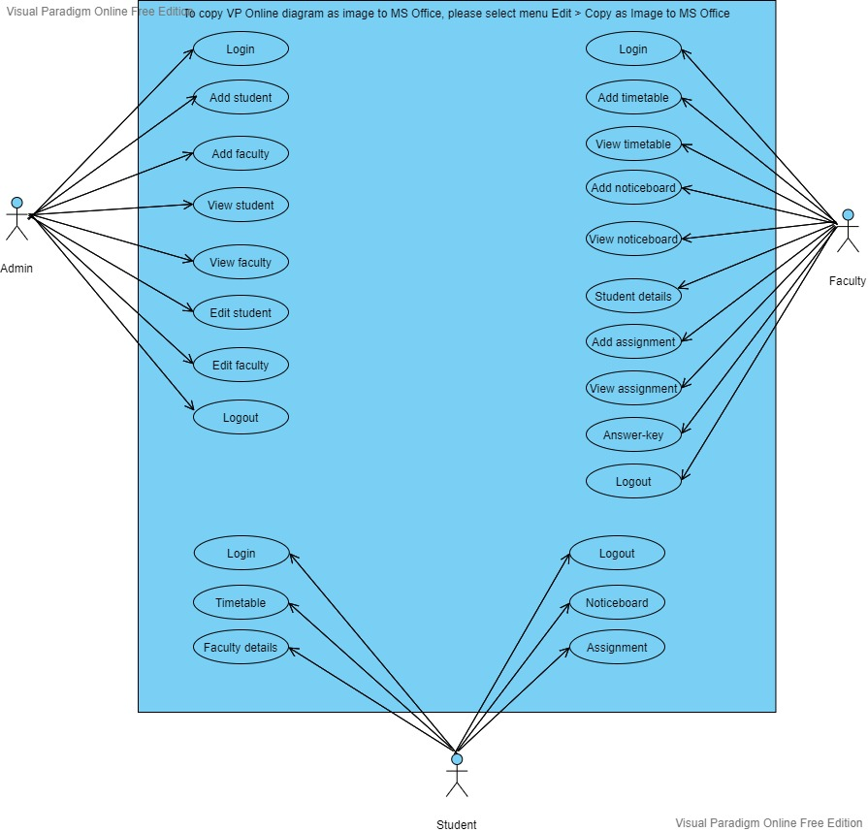
USE-CASE DIAGRAM :

Slide 13
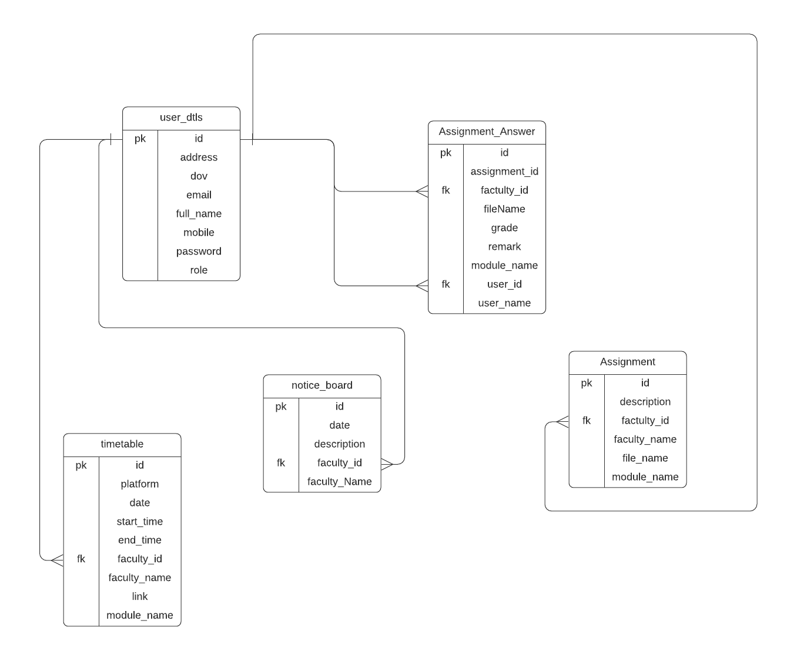
ER DIAGRAM :

Slide 14
conclusion
Student portal for IACSD puts forth the actual working of a institute. Admin modules, Assignment upload and download, grade distribution, adding noticeboard and timetable etc. these are some important modules from our project.
User who is going to access this website should be first associated with IACSD.

Slide 15
Future scope
This project can be enhanced further by adding :
Attendance marking of the students
end module exam
we can also provide mock tests to the students
faculty can give results of mock tests and end module exam.

